Slide 1

Learning to See
By: Preston Dunton

Slide 2
Machine Learning
pattern recognition techniques inspired by the way humans learn

Slide 3
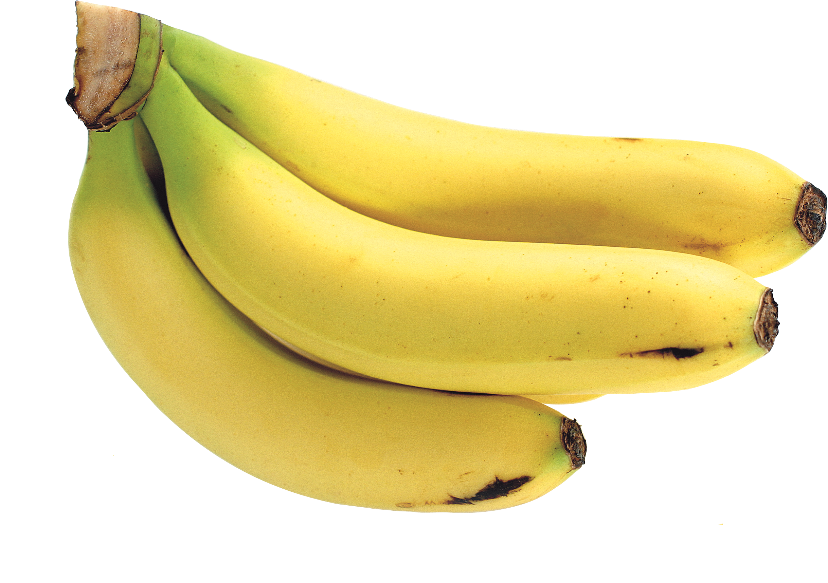
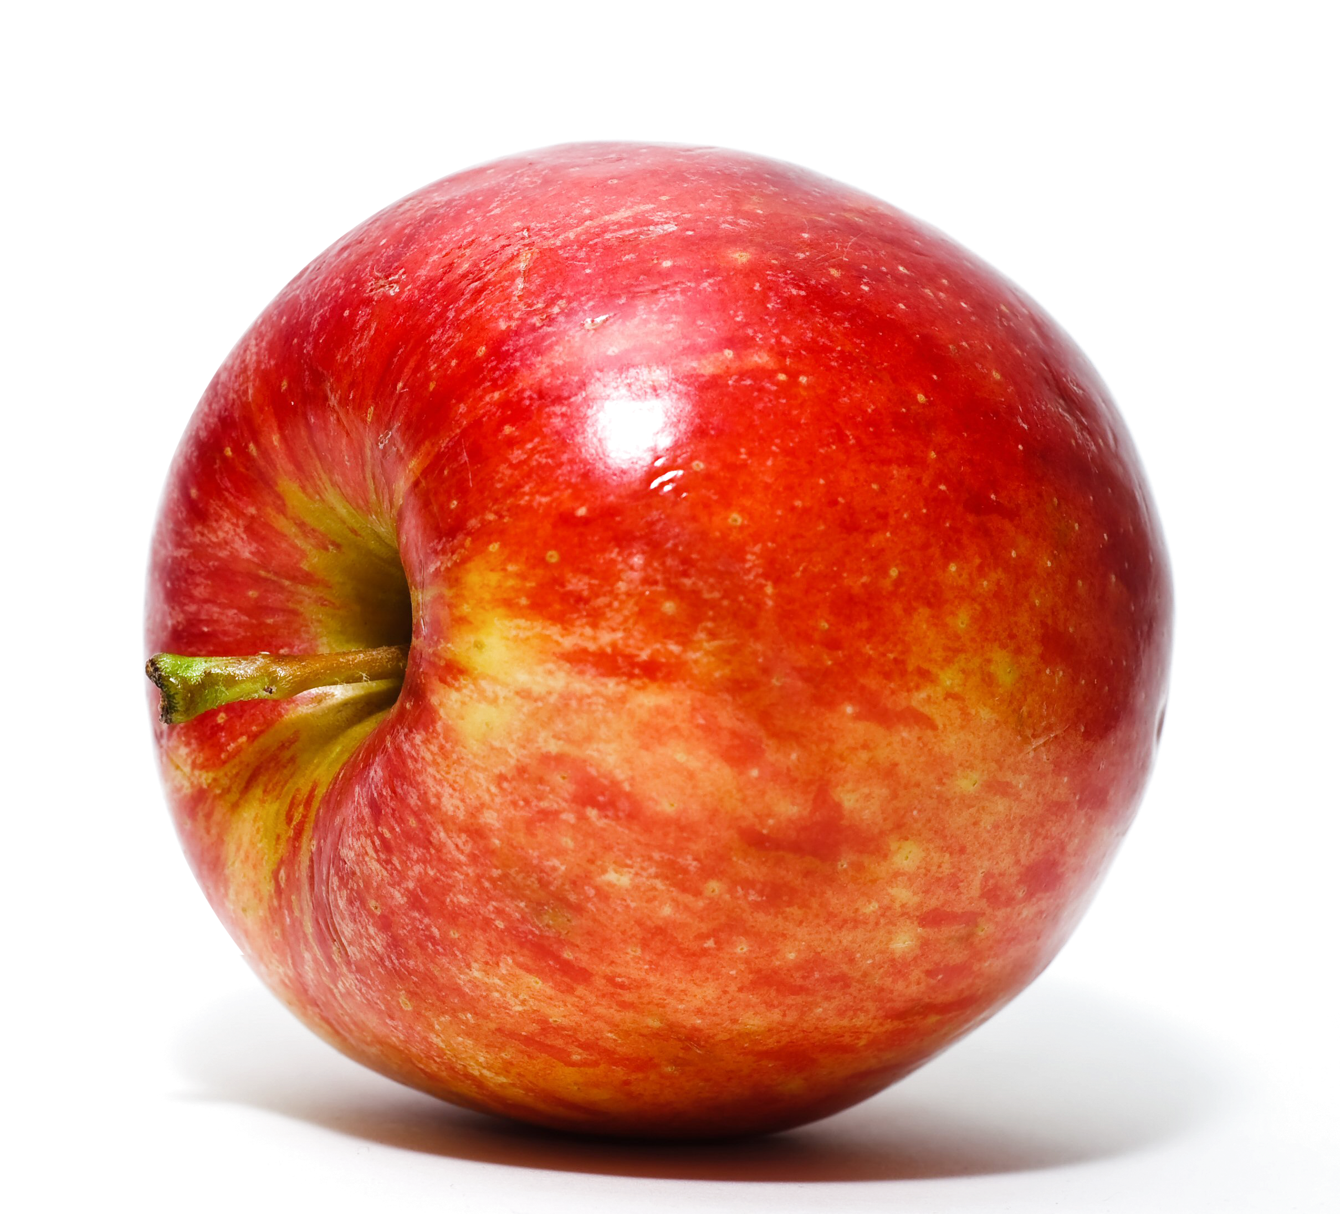
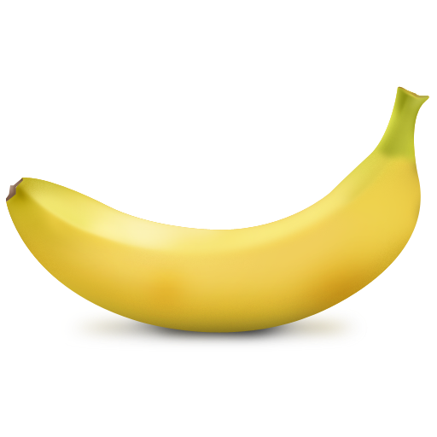
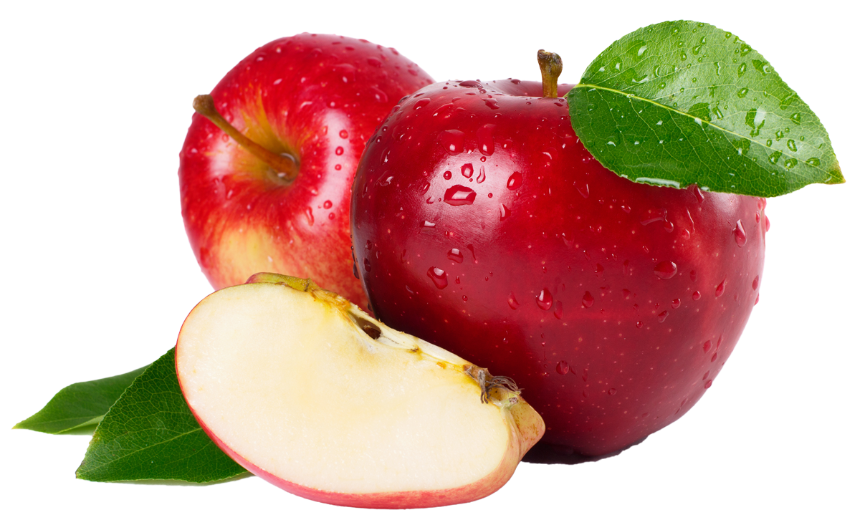
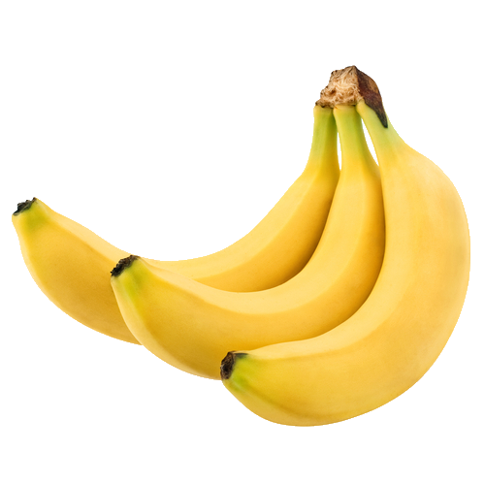
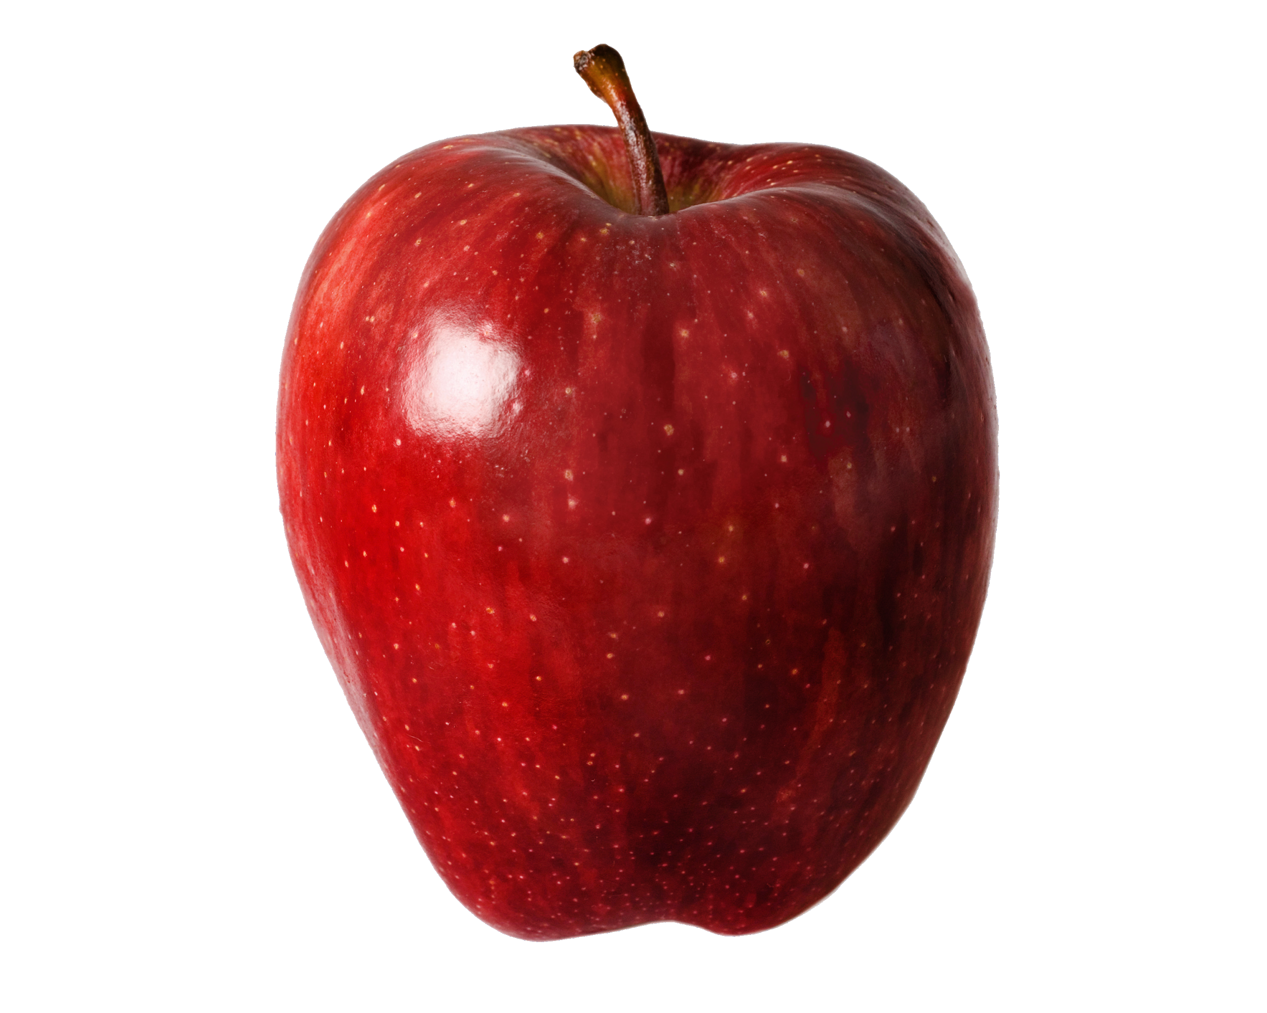
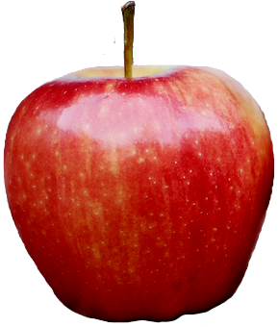
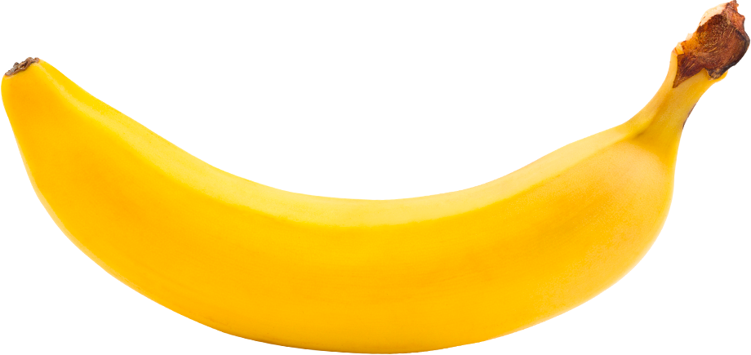
How do apples and bananas look?
Training Data
Bananas
Apples

Slide 4
Bananas
Machine
Predictive Model
Bananas are yellow.
Apples are red.
Apples
Learning

Slide 5
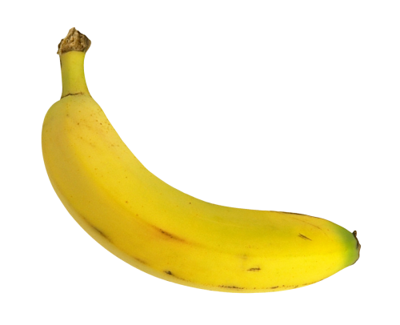
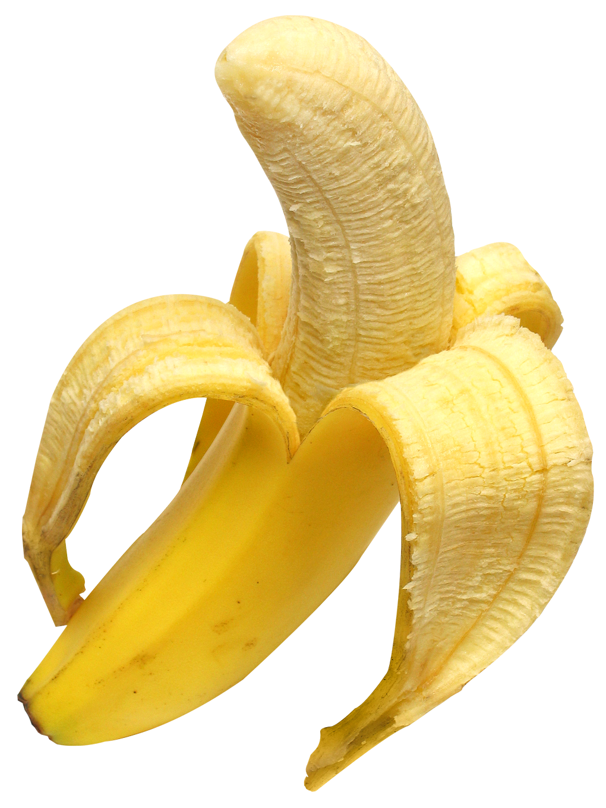
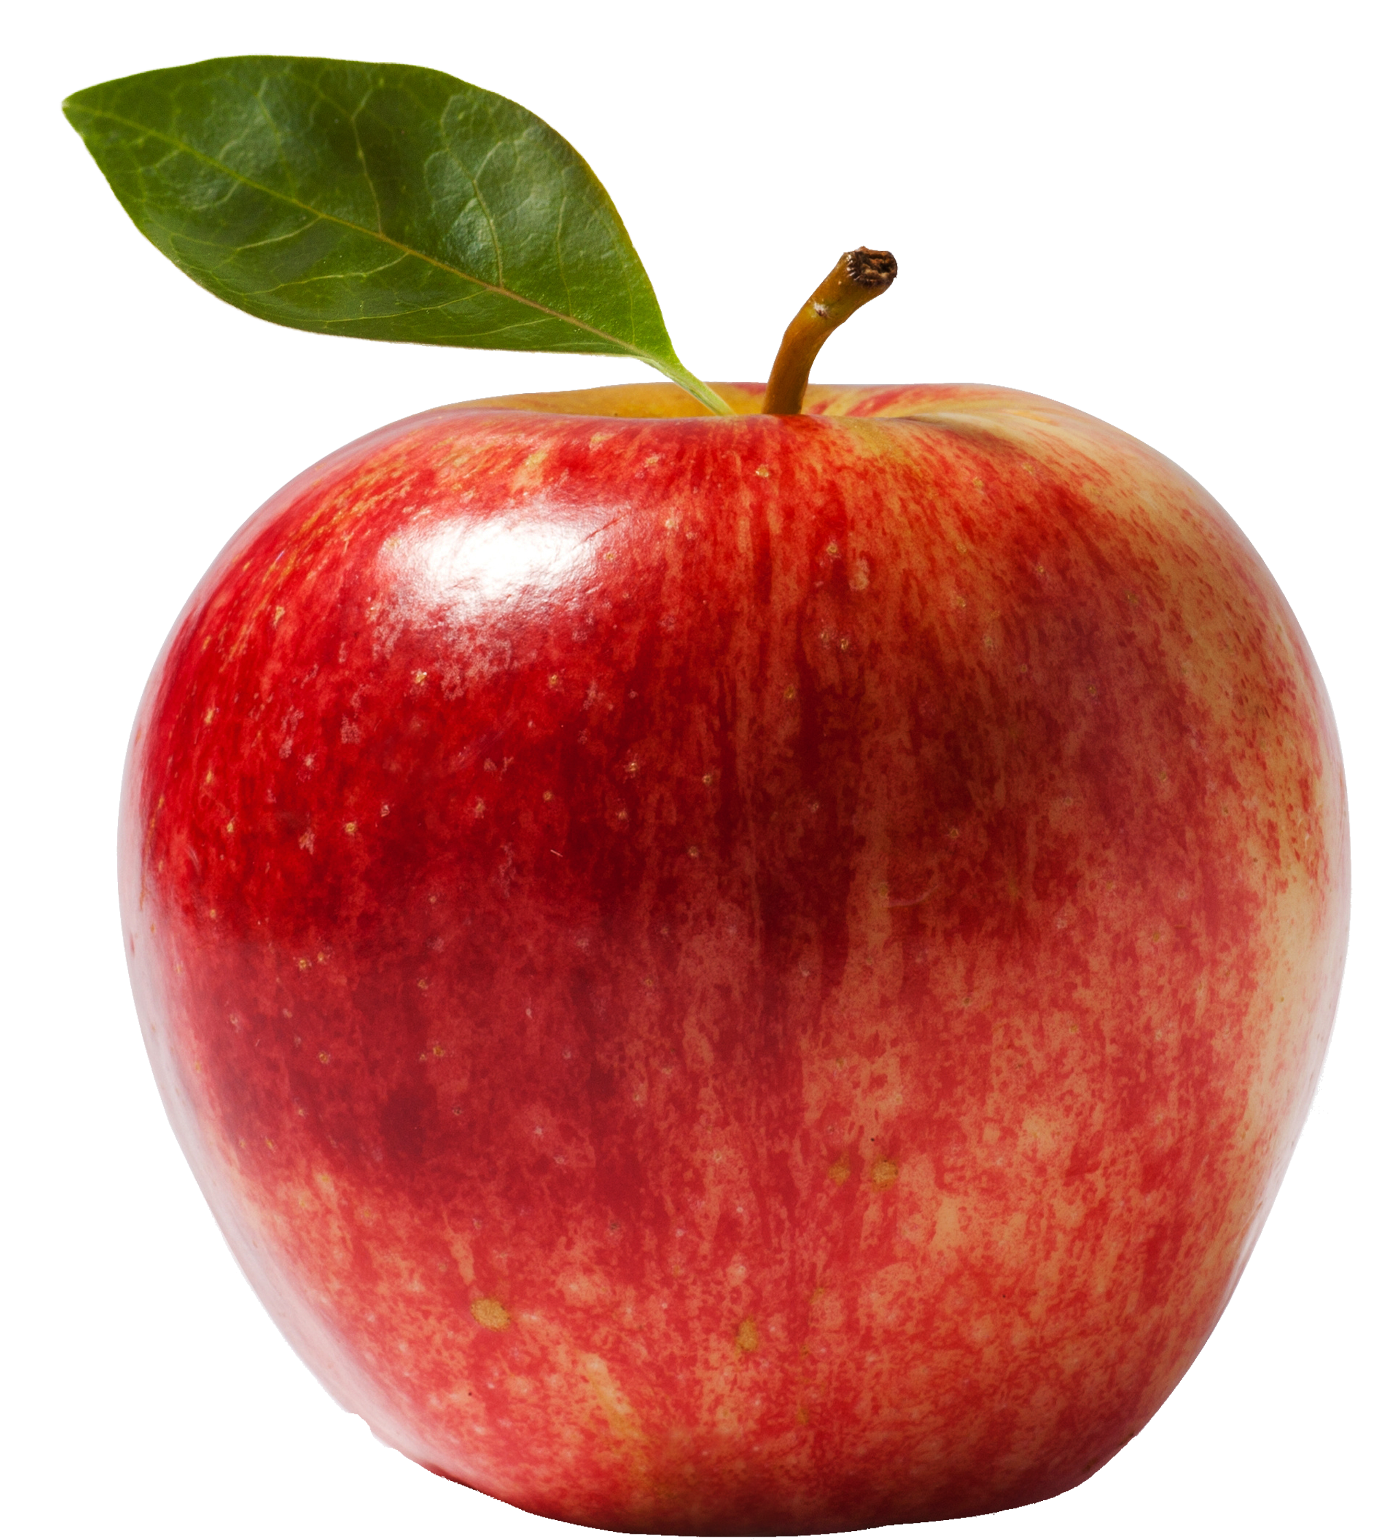
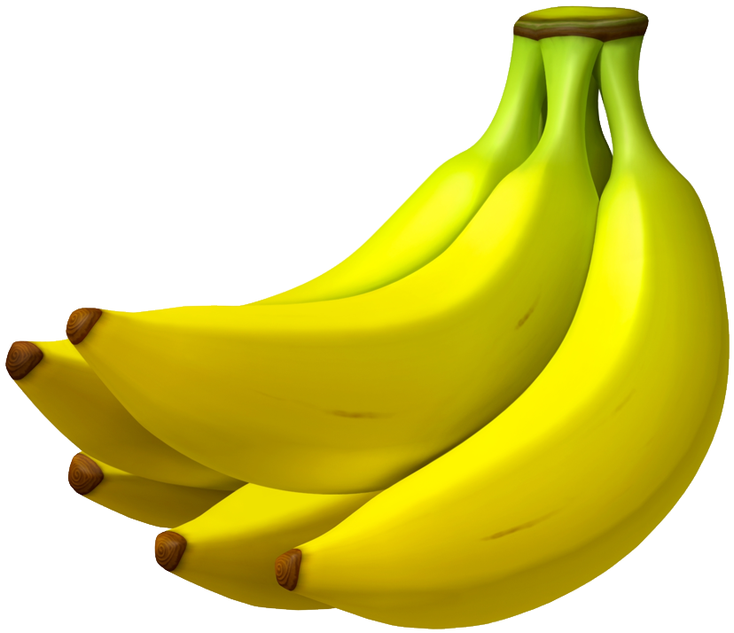
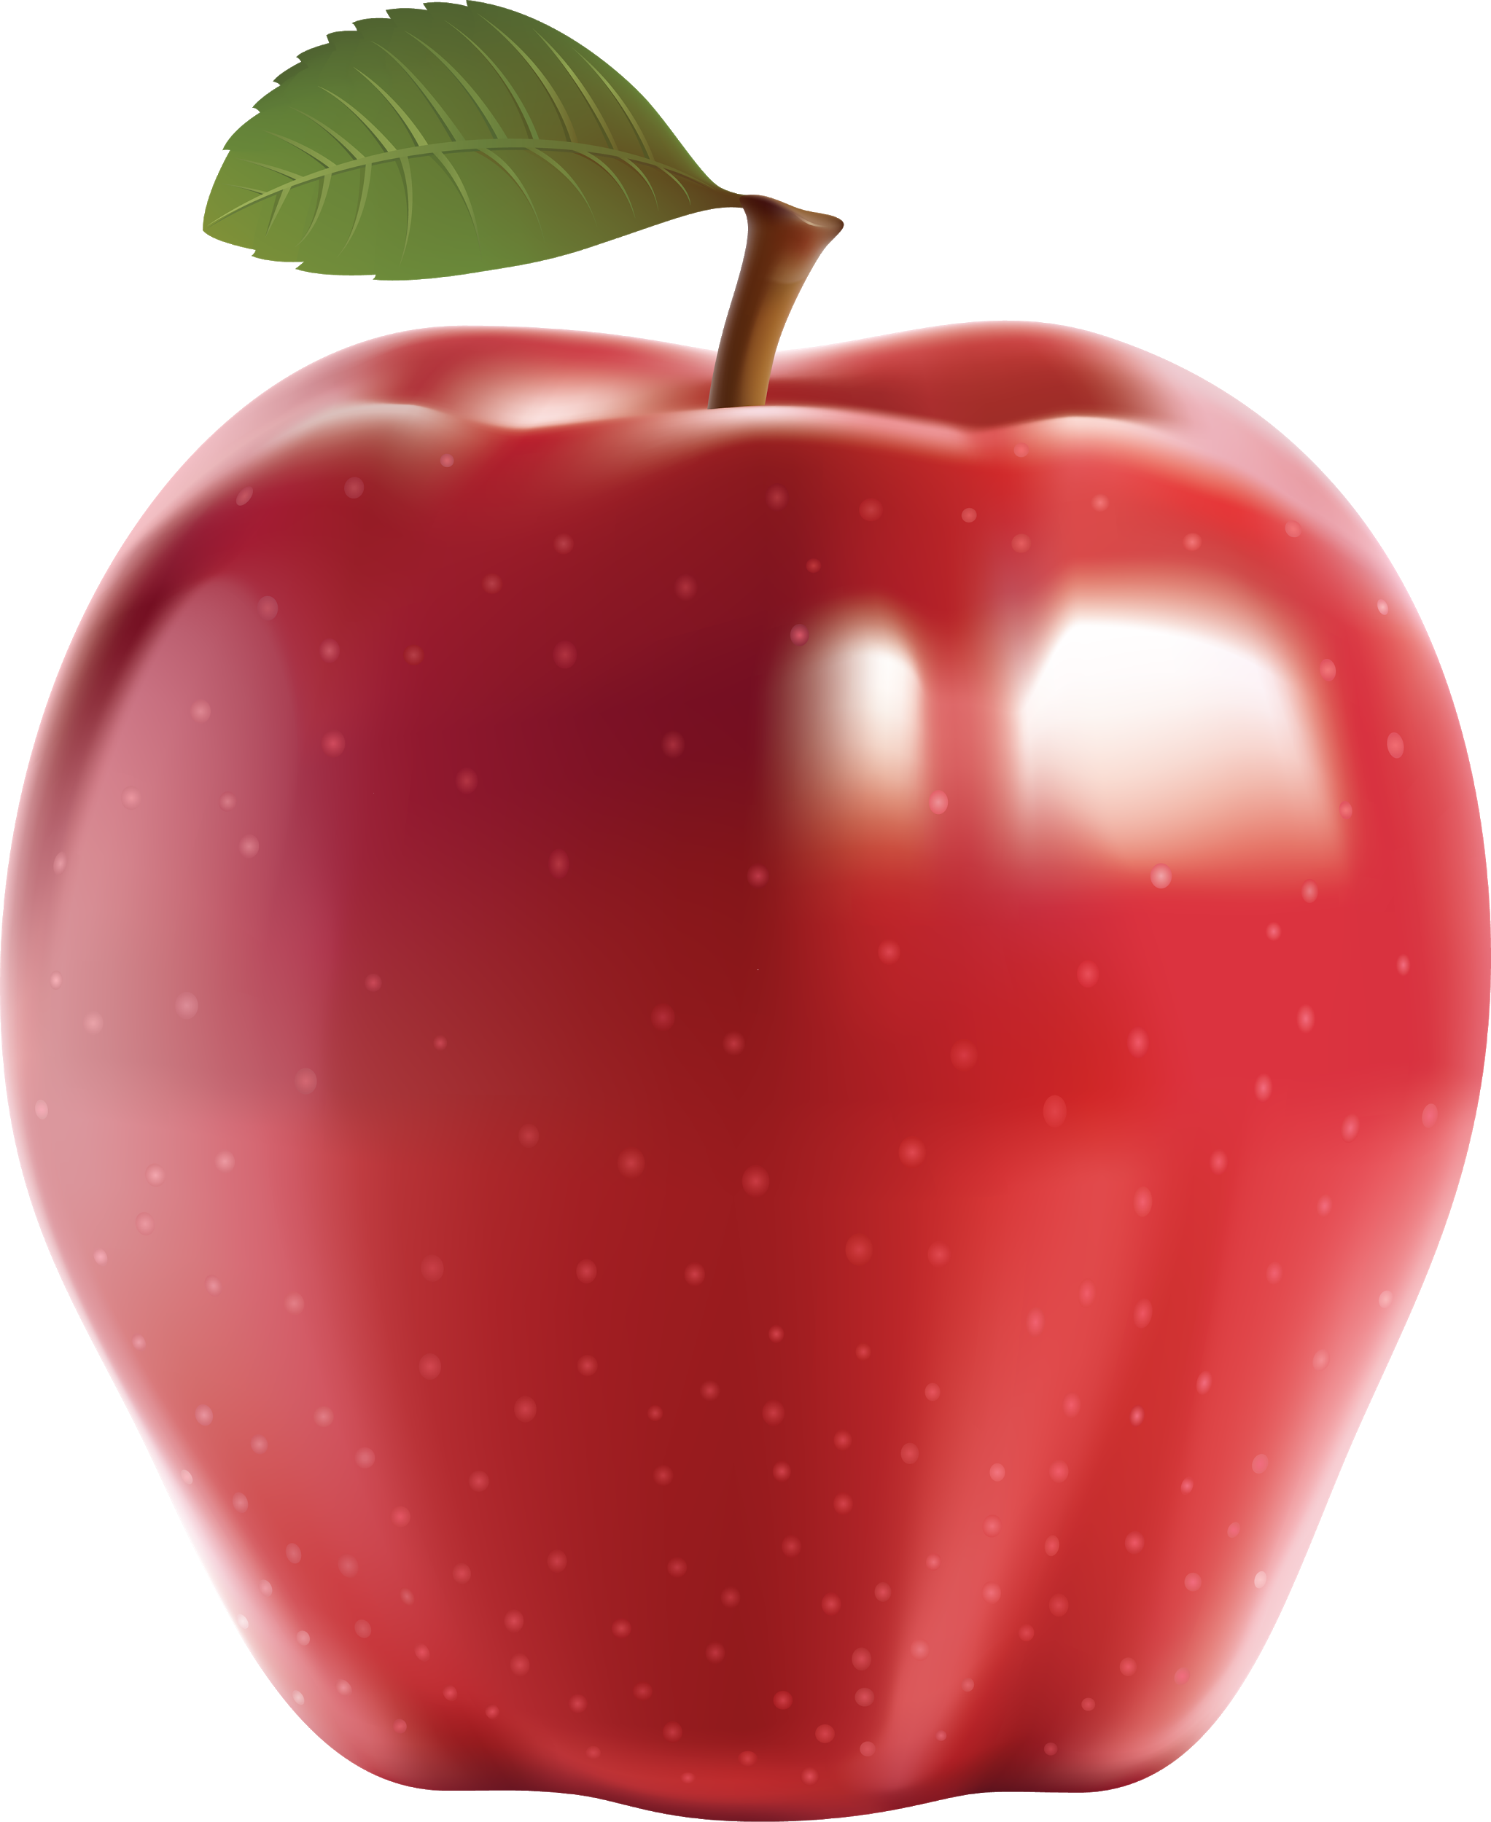
Predictive Model
Testing Data
Bananas are yellow.
Apples are red.
Banana
Apple
Banana
Banana
Apple

Slide 6
Machine Learning Techniques
Supervised Learning
Unsupervised Learning
Reinforcement Learning
Deep Learning
Genetic Algorithms
Artificial Neural Networks
Decision Tree Learning
Clustering Algorithms
Regression Algorithms
Support Vector Machines

Slide 7
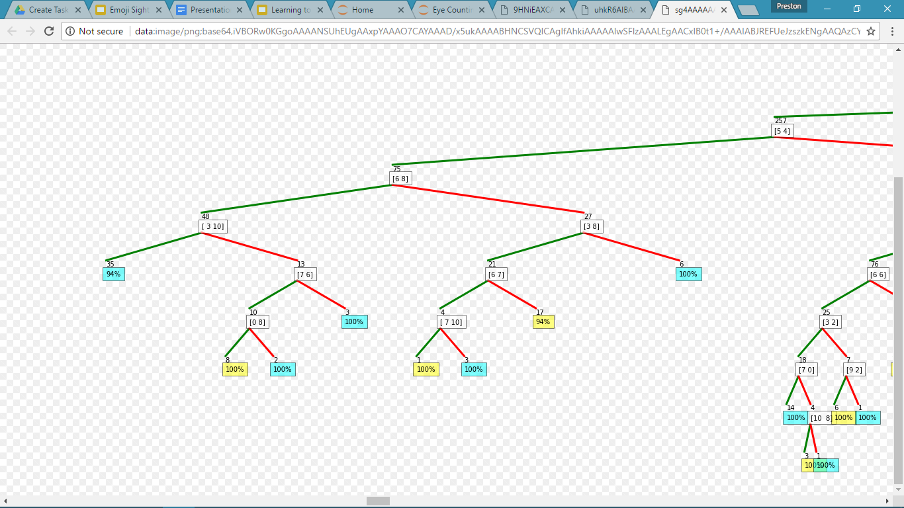
Machine Learning Techniques
Supervised Learning
Unsupervised Learning
Reinforcement Learning
Deep Learning
Genetic Algorithms
Artificial Neural Networks
Decision Tree Learning
Clustering Algorithms
Regression Algorithms
Support Vector Machines

Slide 8
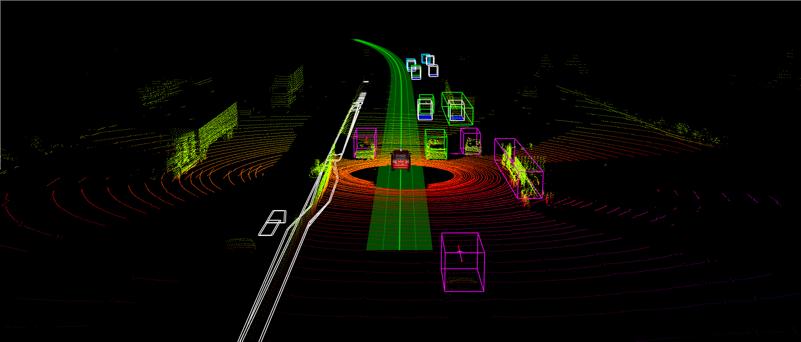

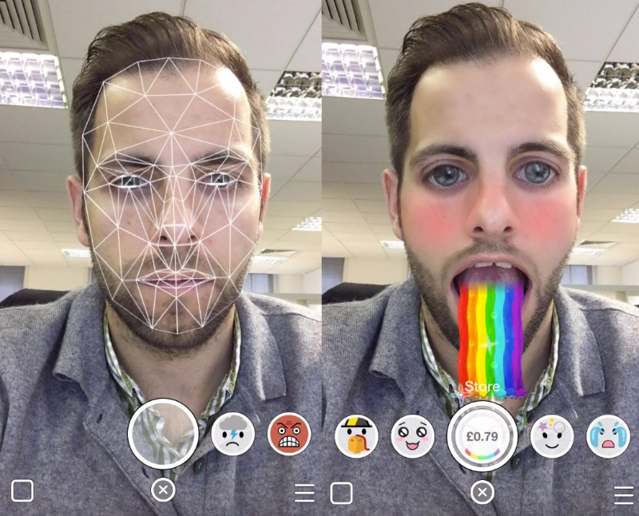
The Task

Slide 9
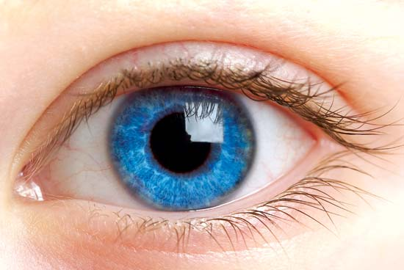


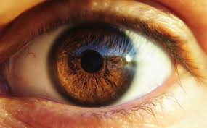

The Task

Slide 10
The Task
Decision Tree
To Identify Eye Pixels
Count Number of Eyes
Count Number of Emojis

Slide 11

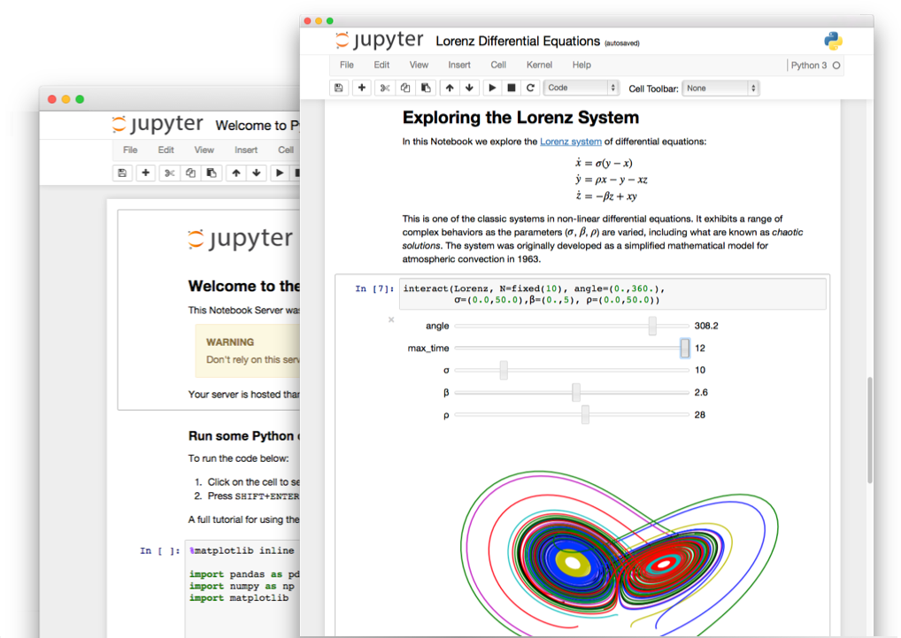

Tools

Slide 12
Decision Trees and the ID3 Algorithm
1

Slide 13
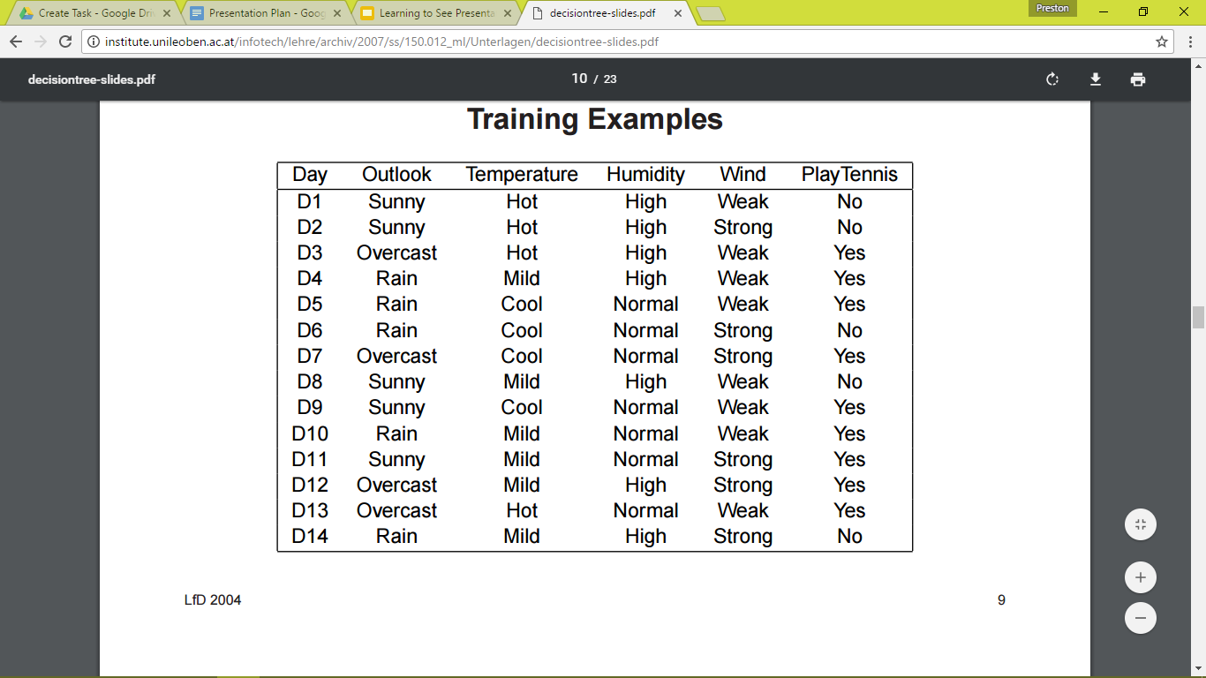
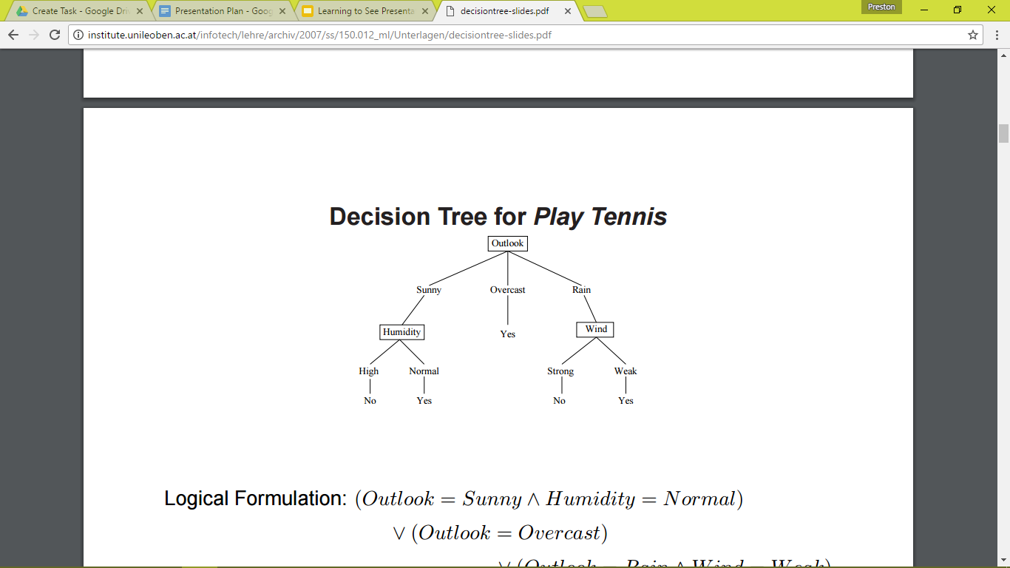

Should we play tennis today?
Positive and Negative Classes
Attributes and Possible Values
Simple and Not Redundant

Slide 14
The ID3 Algorithm
Create root node, that contains all examples

Slide 15
The ID3 Algorithm
Create root node, that contains all examples
Split node on attribute that most cleanly divides classes

Slide 16
The ID3 Algorithm
Create root node, that contains all examples
Split node on attribute that most cleanly divides classes
For each branch, continue to split on node that most cleanly divides classes

Slide 17
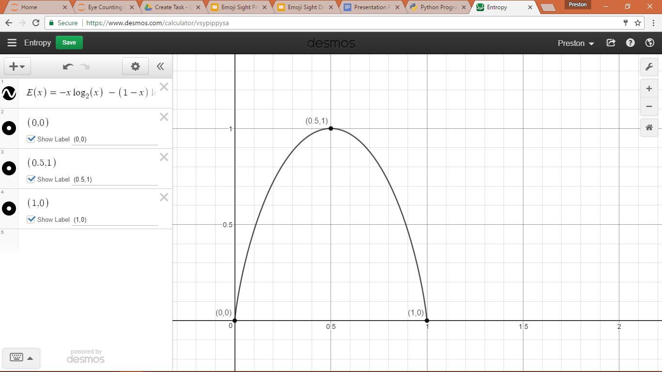
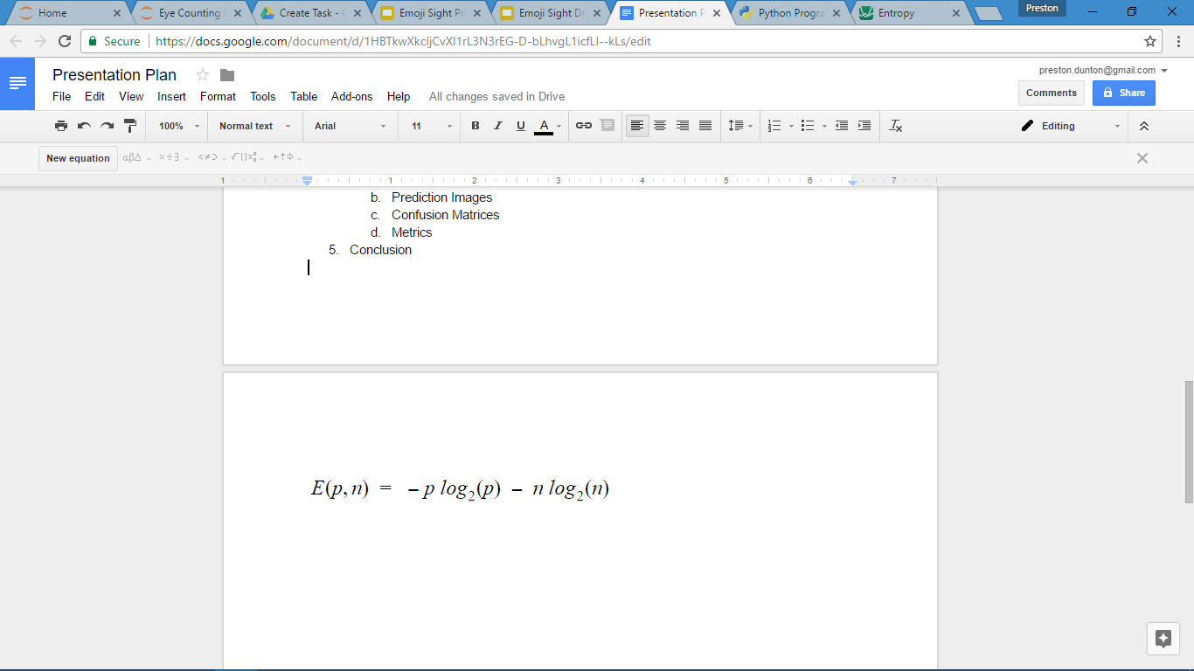
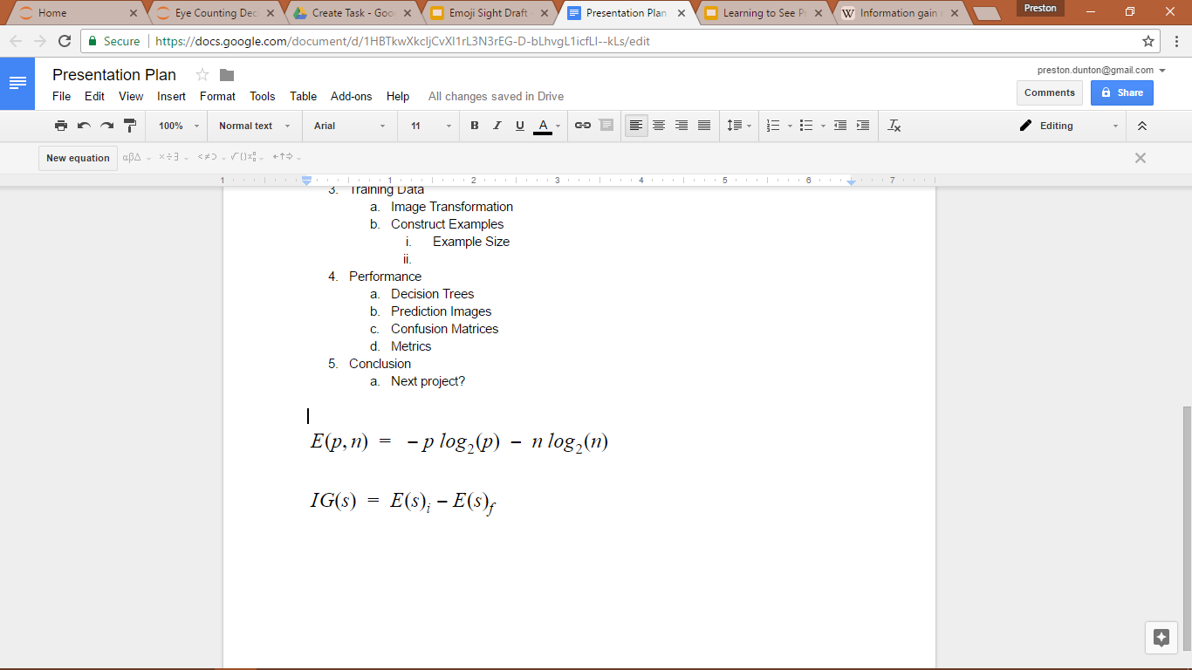
Entropy and Information Gain
Measures Uncertainty
Measures Impurity
Decrease in Entropy
Decrease in Uncertainty

Slide 18
The ID3 Algorithm
Create root node, that contains all examples
Split node on attribute with highest Information Gain
For each branch, continue to split on node with highest Information Gain

Slide 19
The ID3 Algorithm
Create root node, that contains all examples
Split node on attribute with highest Information Gain
For each branch, continue to split on node with highest Information Gain
Stop when all nodes are split

Slide 20
The Bias-Variance Tradeoff
Bias
Variance
Simpler models
Generalizes features
Creates Underfitting
Decision Tree with few branches
Complex models
Memorizes specific features
Creates Overfitting
Decision Tree with many branches

Slide 21
The ID3 Algorithm
Create root node, that contains all examples
Split node on attribute with highest Information Gain
For each branch, continue to split on node with highest Information Gain
Stop when all nodes are split to a specified level of bias/variance

Slide 22

Decision Trees and Emoji Eyes
Classifications: Eye or Not Eye
Attributes: pixels surrounding each pixel
Attribute Values: color of pixel

Slide 23
Training Data
2

Slide 24





Circle Hill Squint
“Circle One” “Circle Two” “Hill One” “Squint One”

Slide 25


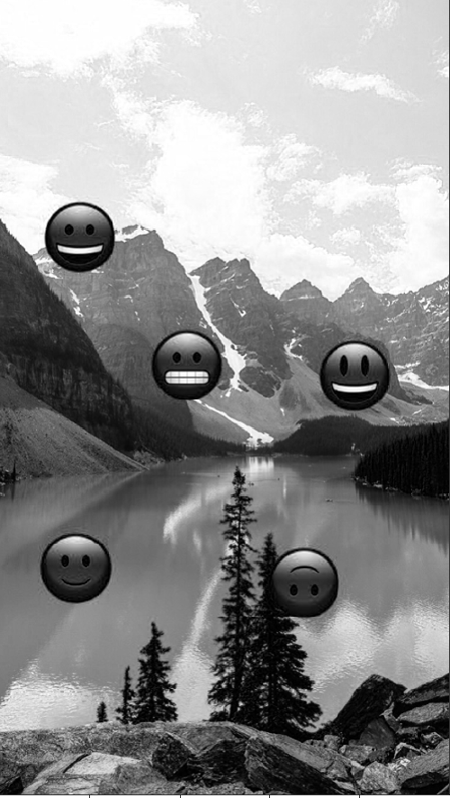
Color
Red to Greyscale
Green to Greyscale
Blue to Greyscale

Slide 26
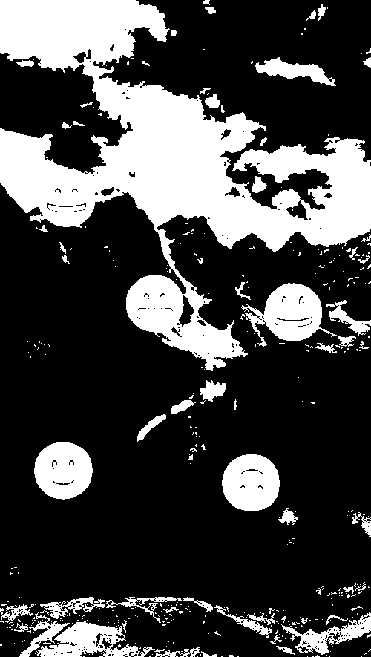
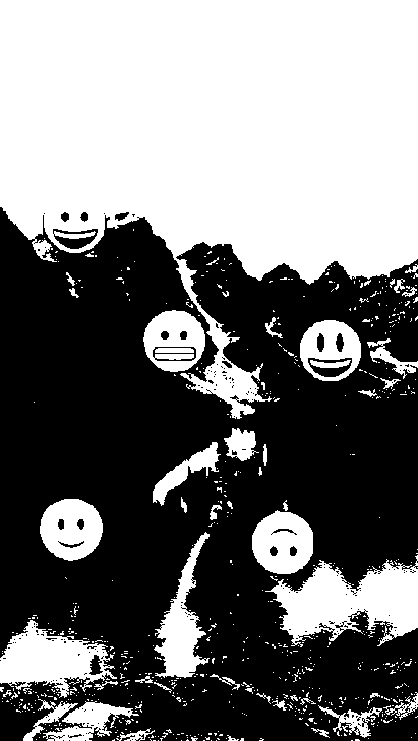
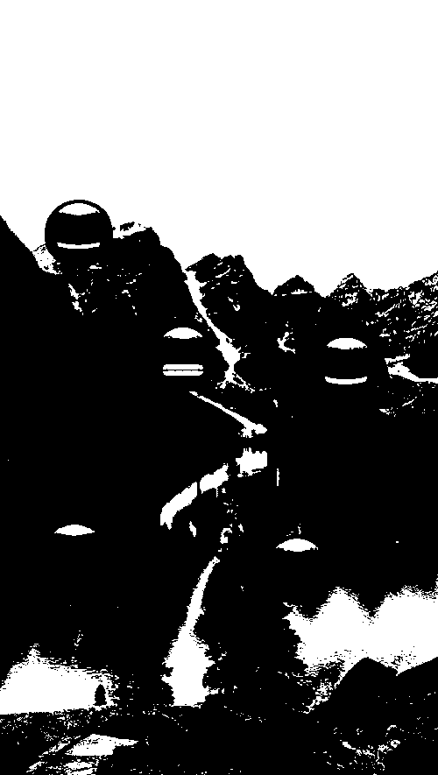
Red Binary
Green Binary
Blue Binary

Slide 27
Complexity
Reduction

Slide 28
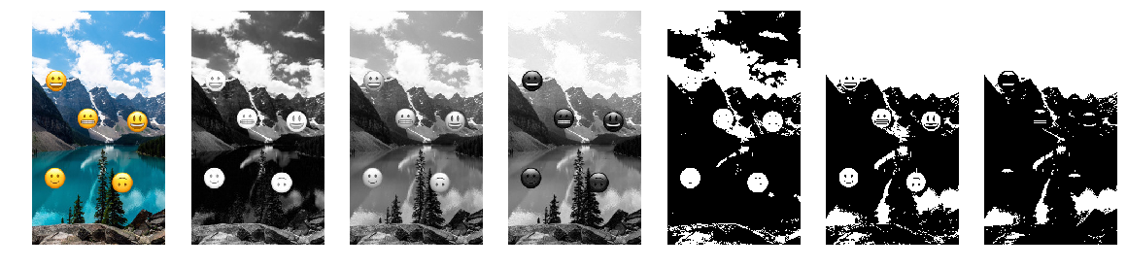
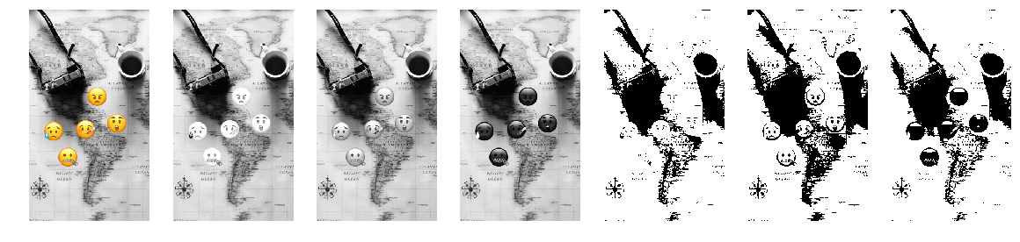

Slide 29
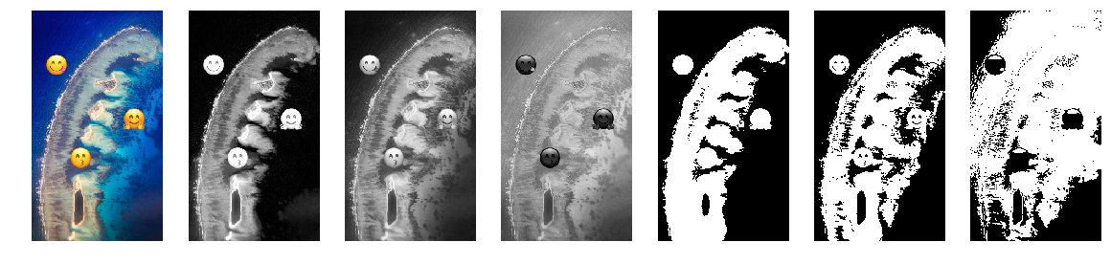
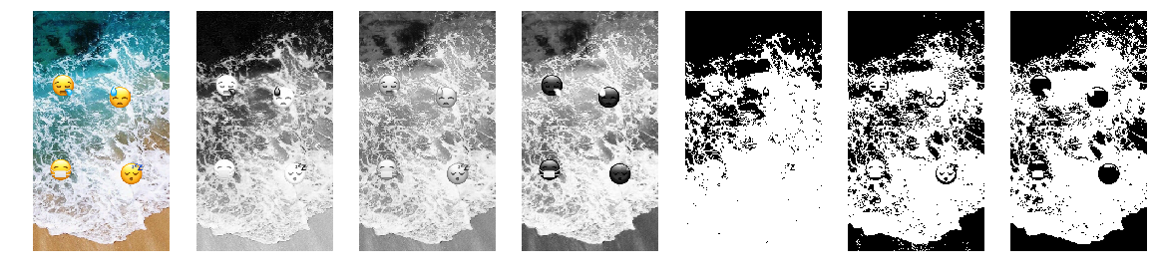

Slide 30



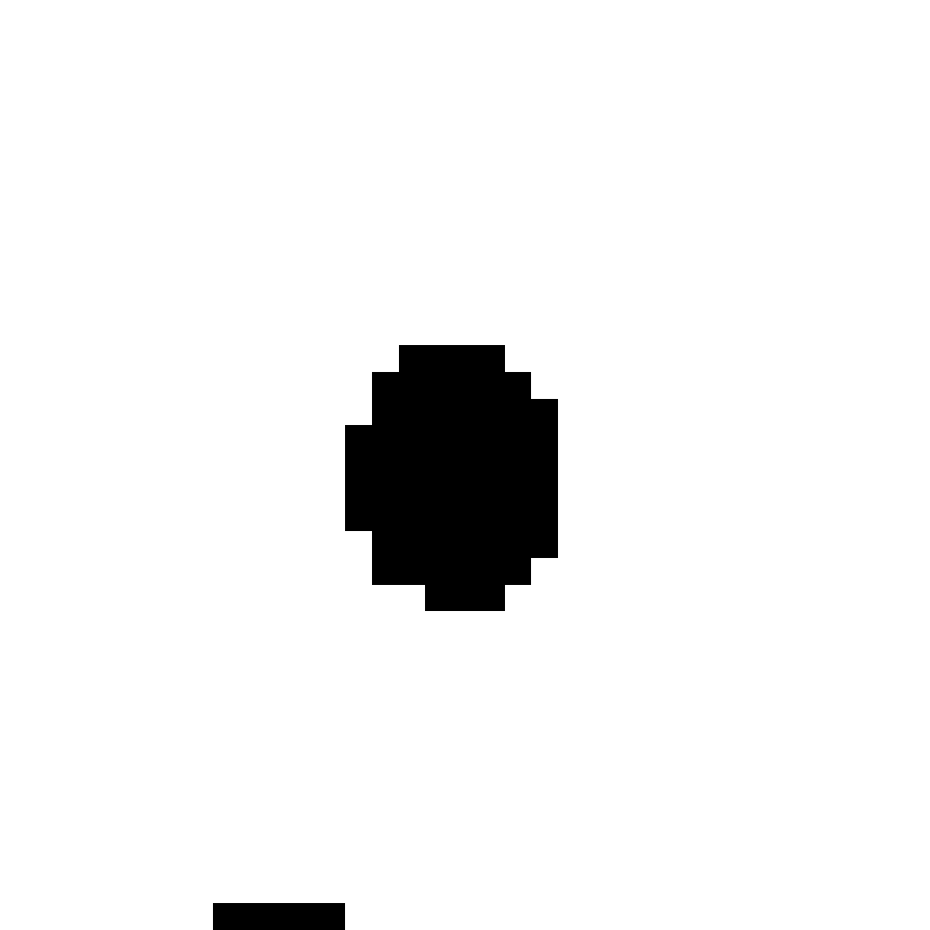

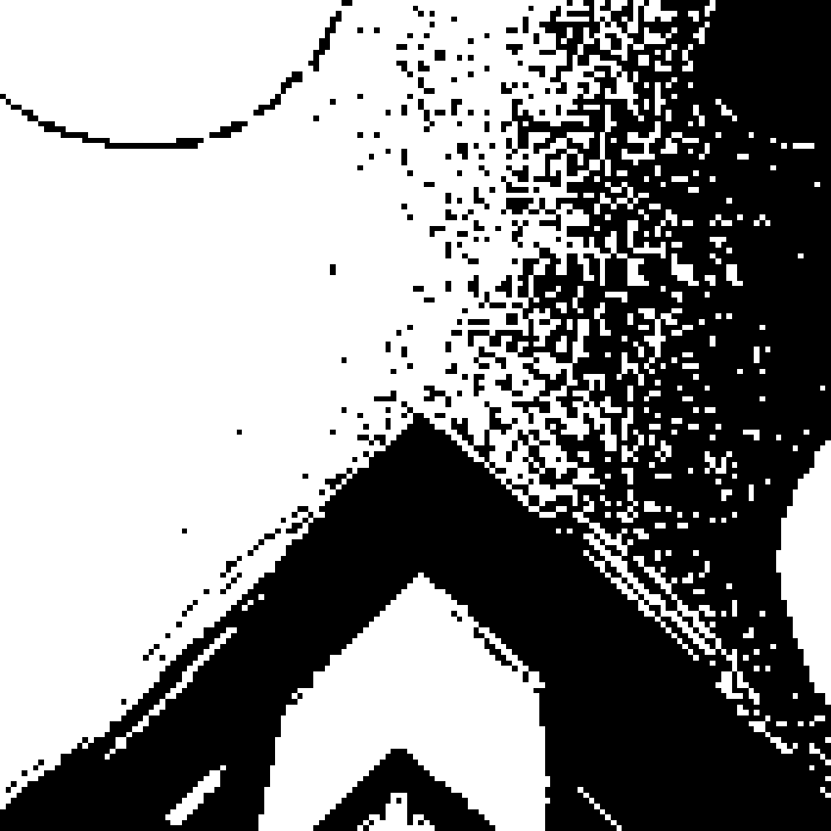




500x500 151x151 55x55 35x35 19x19 3x3 1x1
Decrease in information, attributes to be tested, time

Slide 31






11x11

Slide 32
103,248
11x11 pixel Examples Per Image

Slide 33
Performance
3

Slide 34
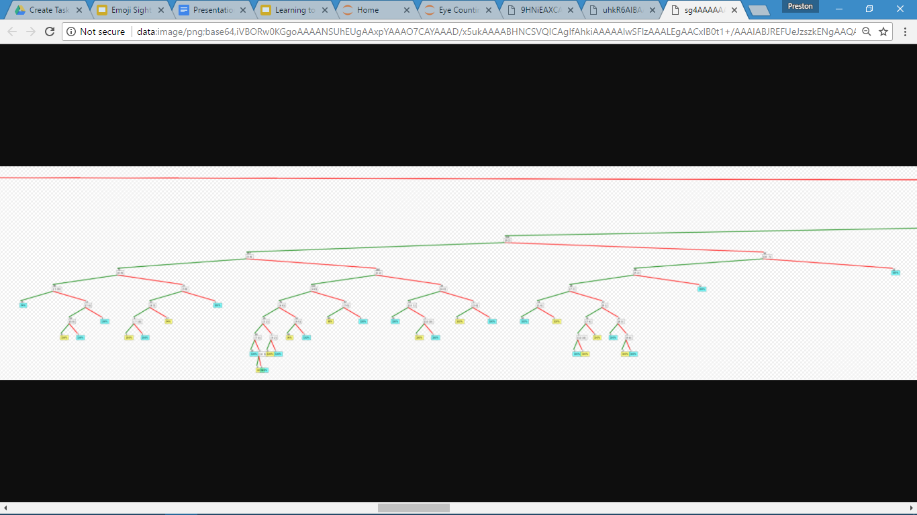
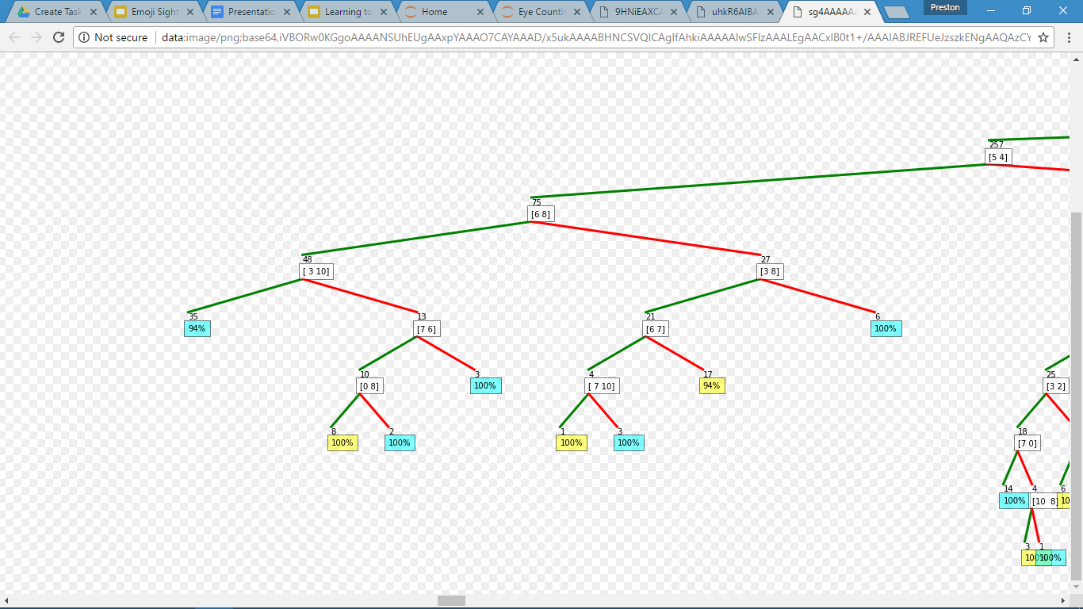

Slide 35



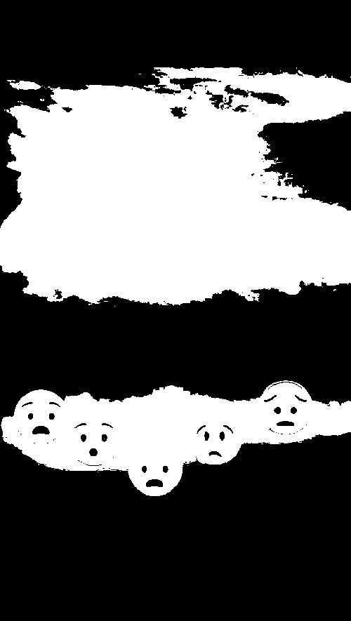


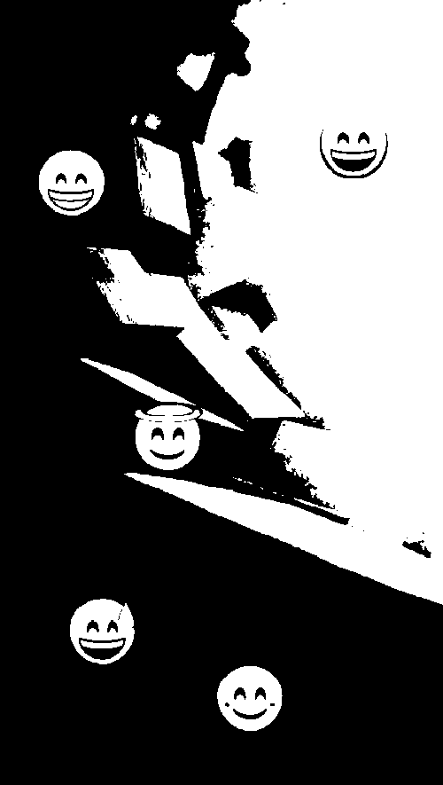

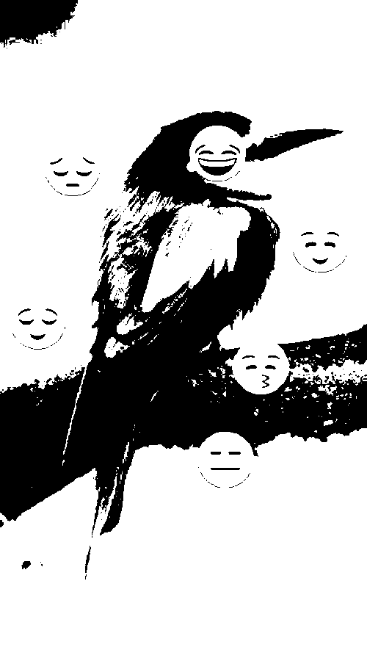
“Circle Three”
“Circle Four”
“Circle Five”
“Hill Two”
“Squint Two”

Slide 36
Confusion Matrices
 | Predicted Positive | Predicted Negative
Actually Positive | True Positive | False Negative
Actually Negative | False Positive | True Negative

Slide 37
Metrics
TP + TN
Accuracy
P+N
When we predict, how often are we correct?

Slide 38
Metrics
TP
Precision
TP+FP
When we predict positive, how often are we correct?

Slide 39
Metrics
TP
Sensitivity
TP+FN
How many positives are we correctly identifying?

Slide 40





Metrics
Accuracy | 99.943% | 99.896% | 99.825% | 99.719% | 99.672%
Precision | 79.245% | 61.694% | 49.835% | 47.738% | 35.601%
Sensitivity | 91.803% | 92.727% | 83.889% | 78.148% | 74.057%

Slide 41
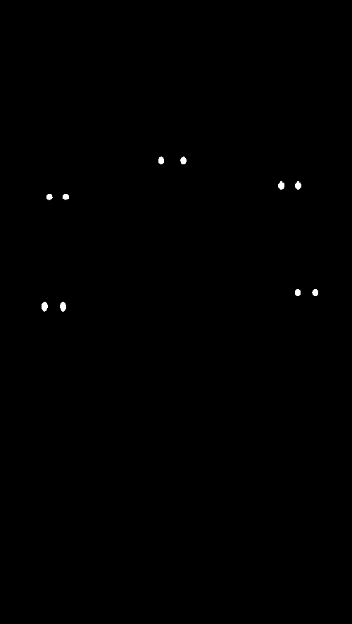
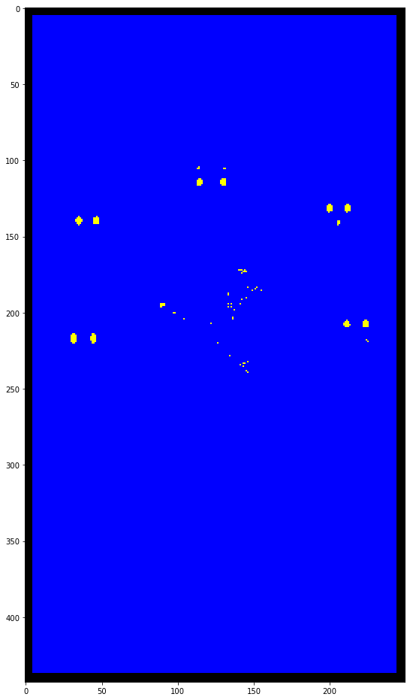

Slide 42
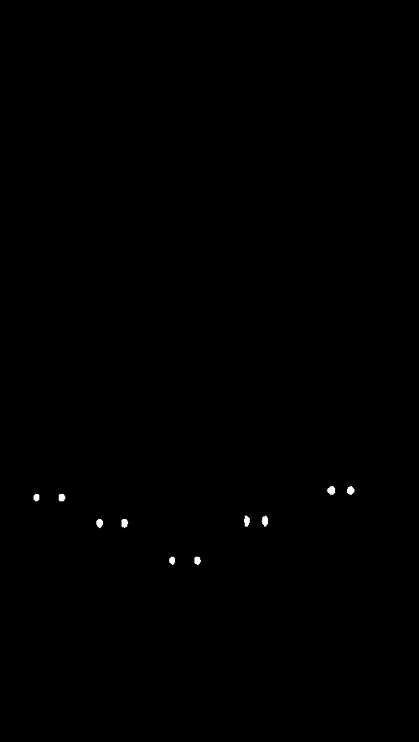
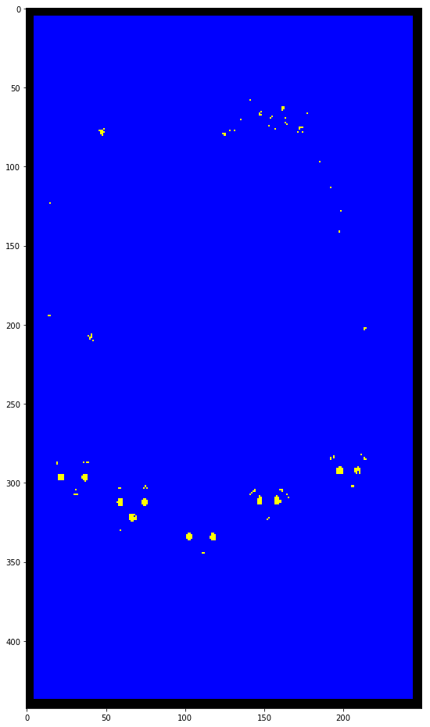

Slide 43
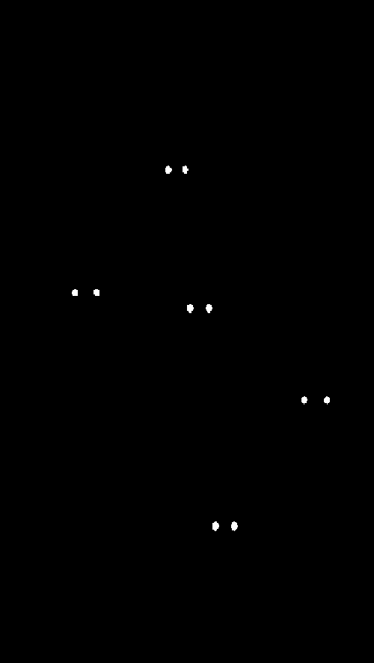
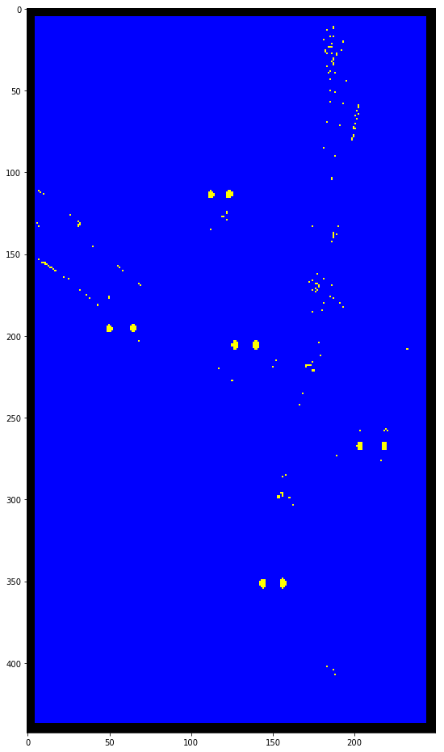

Slide 44
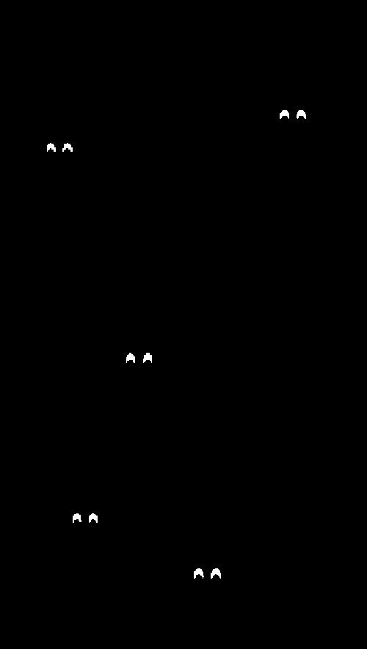
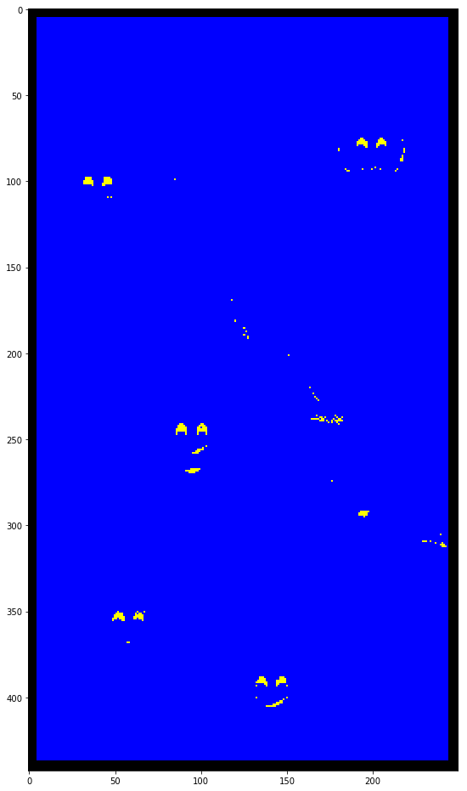

Slide 45
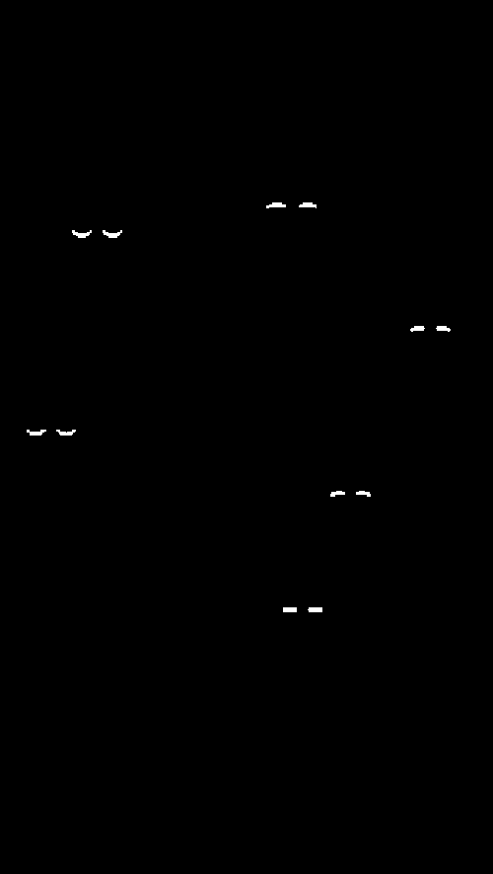
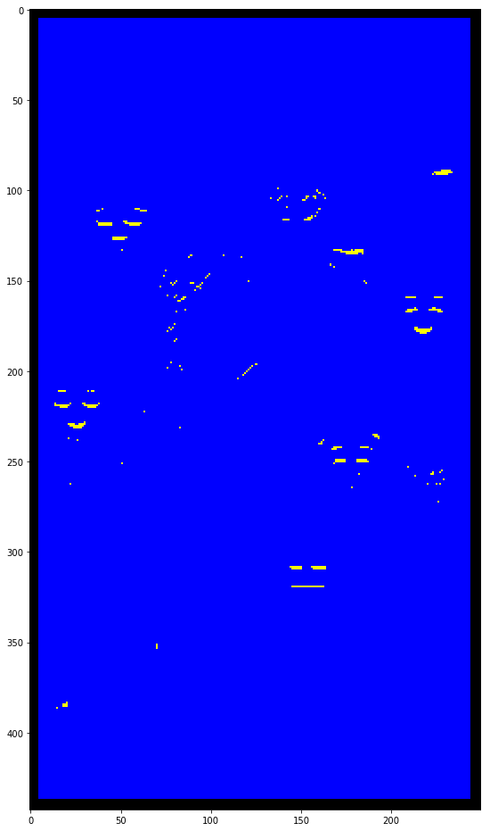

Slide 46

Next Project?

Slide 47
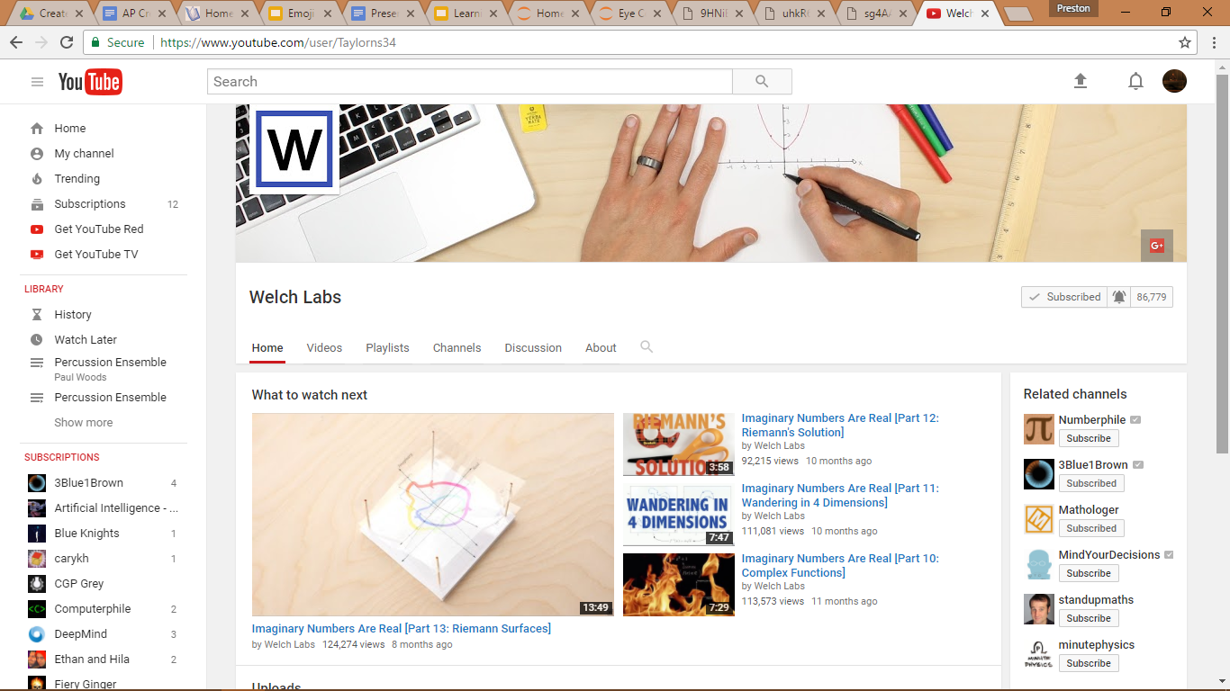


Slide 48
Works Cited
Greensted, Andrew. "Otsu Thresholding." The Lab Book Pages. 17 June 2010. Web. 11 May 2017.
Quinlan, J. R. "Induction of Decision Trees." (1985): n. pag. Machine Learning Theory. Klewer
Academic Publishers, Boston, 2007. Web. 1 May 2017. <http://hunch.net/~coms-4771/quinlan.pdf>.
Learning To See. Welch Labs, 15 Apr. 2016. Web. 11 May 2017.
<https://www.youtube.com/watch?v=i8D90DkCLhI&t=35s>.

Slide 49
Questions?
preston.dunton@gmail.com

